Slide 1

Unit 1A
Development of Multiplatform Applications
Technical English

Slide 2
Index
Vocabulary:
Types of computers:
Task 1
Peripherals
Task 2
Activities 1A

Slide 3
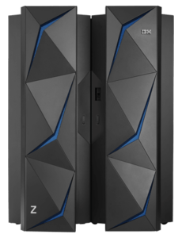
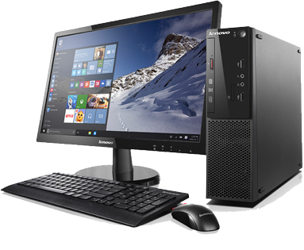
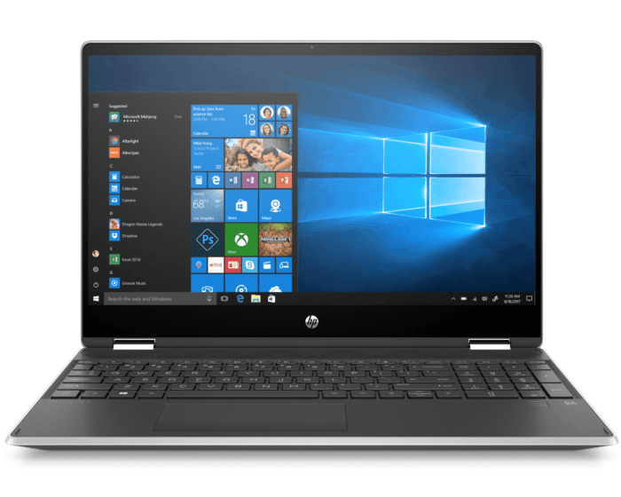
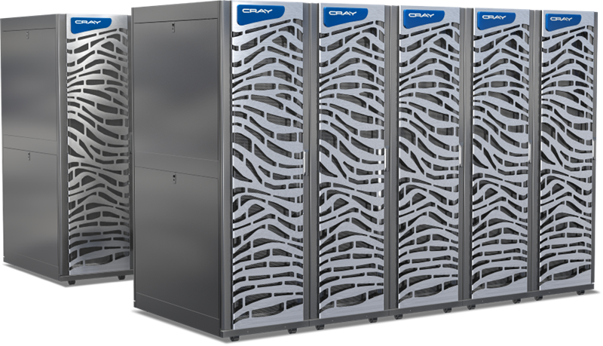
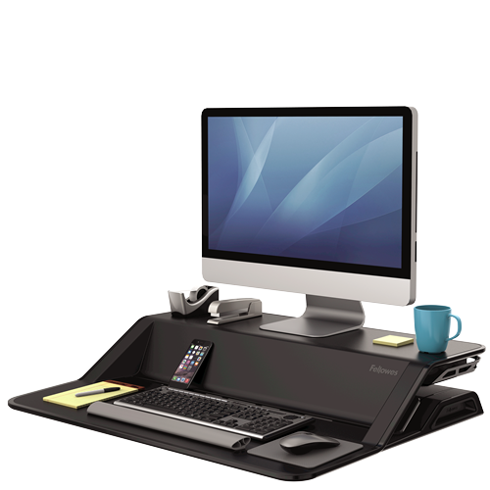
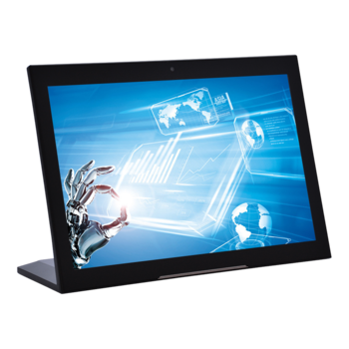
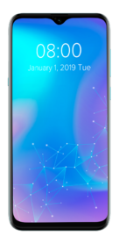
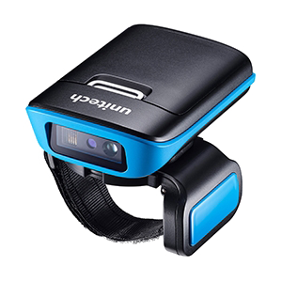
Types of computers
Computer → Machine that can be instructed to carry out sequences of arithmetic or logical operations automatically via computer programming.
a)
b)
c)
d)
e)
f)
g)
h)

Slide 4
Task 1
Order the following items the way they appear in slide 3:
Wrong
tablet PC
laptop
desktop computer
mainframe
supercomputer
smartphone
wearable computer
workstation
Right
mainframe
laptop
supercomputer
desktop computer
table PC
workstation
smartphone
wearable computer

Slide 5

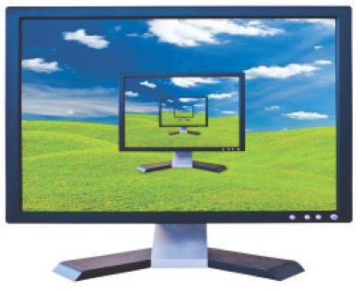
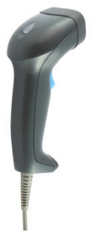
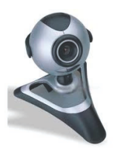
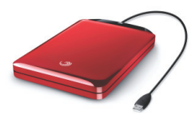
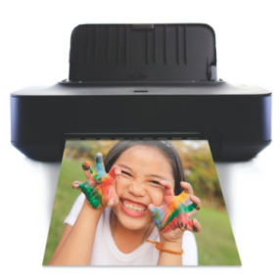
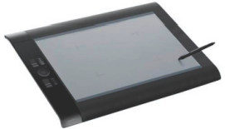
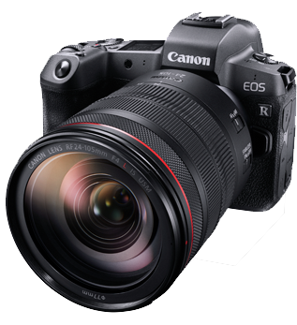
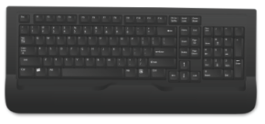
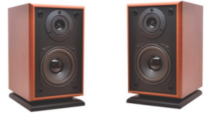
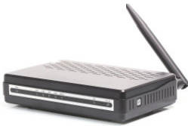
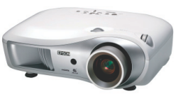
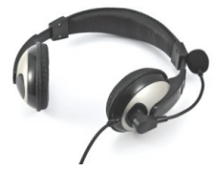

Peripherals

Slide 6
Task 2
Objective? Name as many items as you can.
How? To be done in pairs (write your names!)
Award (added points in Exam Unit 1)
13-14/14 → + 0’25
12/14 → + 0’20
11/14 → + 0’15
10/14 → +0’10

Slide 7
Peripherals (answers)
webcam
portable battery
barcode scanner
mouse
screen
keyboard
(loud)speaker(s)
graphic tablet
camera
printer
router
projector
headphones
USB Flash Drive

Slide 8

Briefing
desktop computer | mainframe | supercomputer | wearable computer
laptop | smartphone | tablet PC | workstation
barcode scanner | portable battery
camera | printer
graphic tablet | projector
headphones | router
keyboard | screen
(loud)speaker(s) | USB Flash Drive
mouse | webcam

Slide 9
Activities 1A
Deadline: Friday 20th September at 23:55
- 0’5/10 for each day of delay
Cheating/copying will mean 0/10

Slide 10
To finish with…
Impact of computers
https://www.youtube.com/watch?v=jtyQJnBGWWo

Slide 11
Any doubt?
Thank you

